Slide 1
Automatic Scoring up of Parts in Mensural Notation
Martha E. Thomae, Julie E. Cumming, Ichiro Fujinaga
Centre for Interdisciplinary Research in Music Media and Technology (CIRMMT)
McGill University
Medieval and Renaissance Music Conference
Maynooth, 06 July 2018
Notes:
[Next Slide Beg:] THIS TOOL IS MEANT TO WORK WITH MENSURAL MUSIC. Mensural music refers to vocal polyphonic music written between the 1250s and the 16 HUNDRED, which used an older system of music notation called “mensural notation”
HERE WE HAVE an example of a mensural piece [Click!]

Slide 2
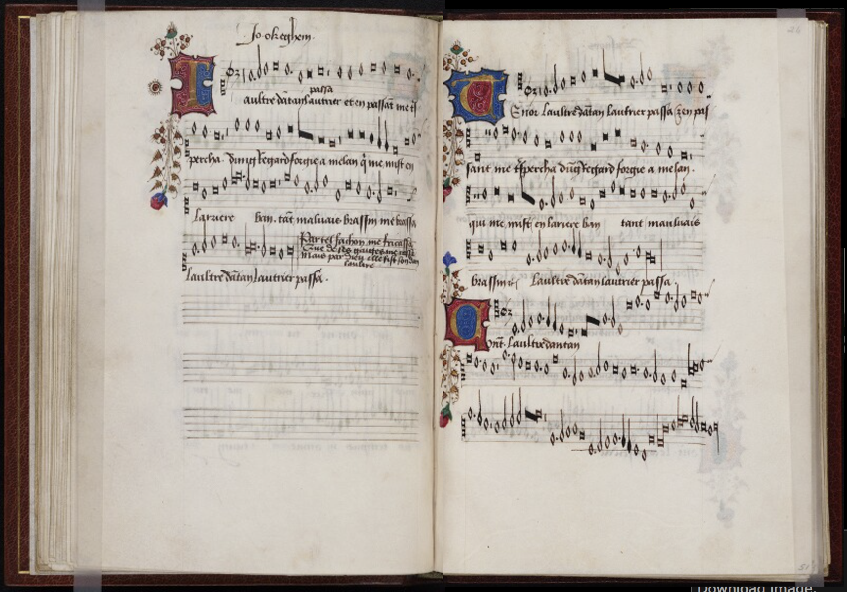
Superius
Tenor
Contratenor
Beinecke Rare Book & Manuscript Library
Mellon Chansonnier (MS 91), 25v-26r
Notes:
Most mensural music was written in separate parts
the voices are presented separately: in different areas of the page or in books
You can see that in this example
So here we have the opening of a book
That contains a single piece -> This is L’Autre D’Antan by Ockeghem -> It is a mid-fifteenth century piece
Each of the 3 voices lies on a different area of the opening
S, T, C
In this separate arrangement of the voices you can capture all the melodic information of each voice.
But you are not able to visualize that easily the vertical sonorities.
In other words, you are not able to see the notes that are being sung at the same time in the different voices, which would be evident if the piece was presented in score format instead. [I.E. -->}

Slide 3
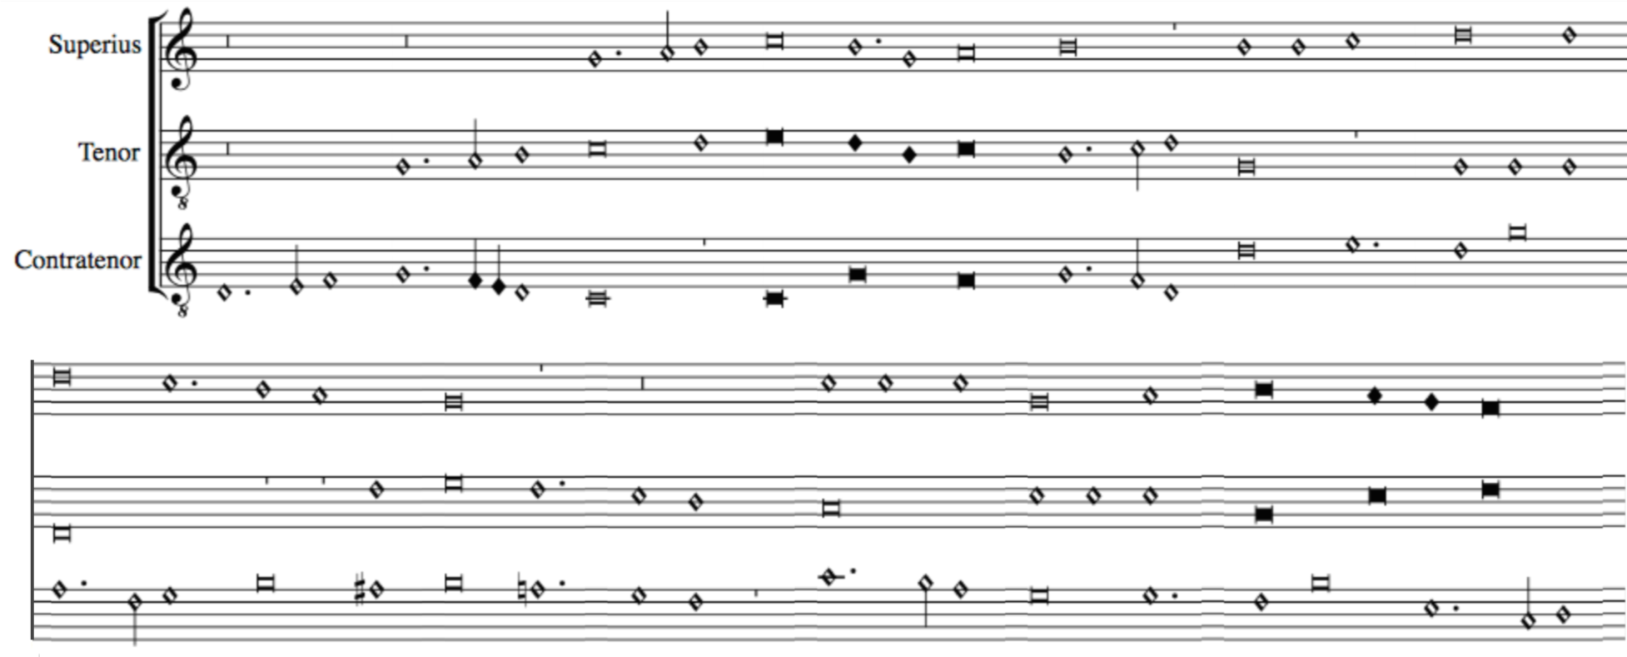
Scoring up
Notes:
So here we have the same piece (just in score format)
You have access to the same melodic information
But also --> the vertical sonorities. You can visualize ...
To facilitate counterpoint studies (this is, the study of the relation between the voices)
Goal: pass from this representation [parts] to this representation [score]
We REFER to this process as SCORING UP
We are developing an Automatic Scoring-Up Tool

Slide 4
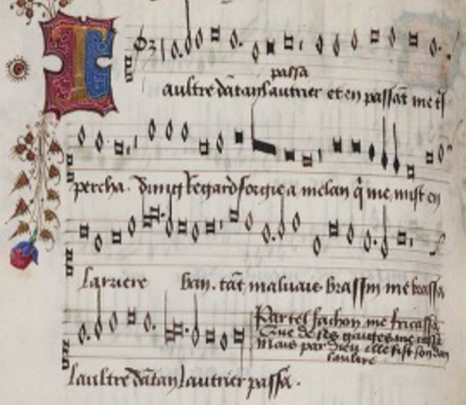
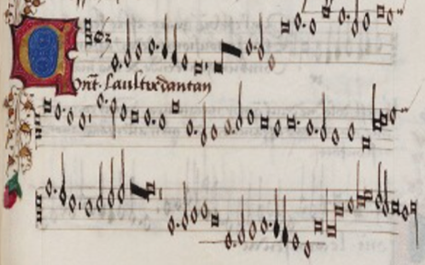
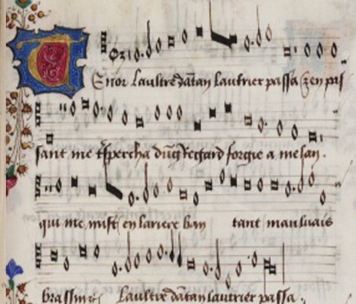
Scoring-up Tool
File 1
________
________
________
Scoring-up
Tool
Output File
________
________
________
________
________
________
Superius part
File 2
________
________
________
Contratenor part
SCORE
File 3
________
________
________
Tenor part
Notes:
which basically:
Will take a set of files, each of them contains information regarding a single part.
The Scoring-up tool process these files
And returns a single file that will represent the piece in score format.
So, even though the TASK of the "scoring-up tool" SEEMS PRETTY SIMPLE (just lining-up the notes of the different voices), it is COMPLICATED BY THE NATURE OF THE NOTATION ITSELF.
[CLICK!] So lets talk about mensural notation...

Slide 5
Mensural Notation 101
Notes:
In this short tutorial I am going to give you the basics of mensural notation, which are actually the foundations behind the scoring-up tool

Slide 6
Beinecke Rare Book & Manuscript Library
Mellon Chansonnier (MS 91), 25v-26r
Notes:
Mensural notation is the immediate predecessor of our Common Western Music Notation system, and when IT started, we already had an EXPLICIT way to notate PITCH:
Staff-lines
Clefs
But the same did not applied to rhythm yet.
1. We already had DIFFERENT NOTE-SHAPES as you can see here, BUT they did not EXPLICITLY conveyed the duration of the note.
2. It is COMMON to have the SAME note shape being used twice, even next to each other, and representing different durations…
3. This AMBIGUITY of the note DURATION COMPLICATES the SCORING-UP TASK, because in order to line the notes up we need to know their duration.

Slide 7
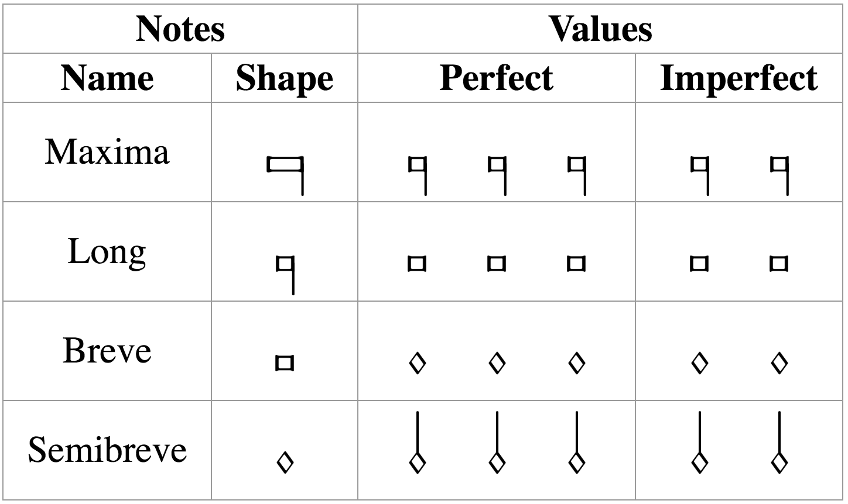
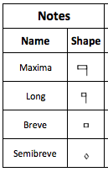

Mensural Notation
There is a clear hierarchy in the note duration
longest
shortest
Mensuration
Establishes the relation between the note values (“perfect” or “imperfect”)
3 x 2 x 1 x 3 x
Notes:
Like I said, we already have different note shapes and there is a clear hierarchy regarding the note duration
But, each note shape can have two different values, it can be ternary (perfect) or binary (imperfect).
So we have examples like ... in which (3, 2)
So, how do we know what is the value of a note?
We have this IMPORTANT concept in mensural notation: MENSURATION
So what about …? In imperfect mensuration → No Ambiguity
The challenge occurs when dealing with PERFECT MENSURATION at ANY OF THESE FOUR NOTE-LEVELS (it could be in the four at once). [CHANGE SLIDE]

Slide 8
In perfect mensurations, the duration of the individual note symbols is not absolute, but rather depends on context
Notes:
The MENSURATION gives us a semifixed relation between the duration of the notes, but that relation can be changed by the context (I.E., THE NOTES AROUND)
AND IT IS THIS CONTEXT-DEPENDENCY ISSUE THAT IS THE MAIN FOCUS OF THE SCORING-UP TOOL
There are certain principles on how context affects the note value. I am not going to enumerate all of these principles, but I will give an example of the general idea of on how these principles work.

Slide 9


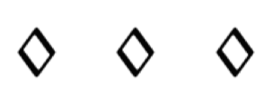


Examples of Context Changing the Note’s Duration
Mensuration: Breve = 3 → Breves are perfect by default
Principles of
Imperfection
and Alteration
Imperfection
Perfect → Imperfect
Alteration
x 2
Franco of Cologne
Ars Cantus Mensurabilis (ca. 1280)
Notes:
1. This breve is perfect, this breve is perfect, and so on…
2. That is the idea in perfect mensuration, we have this triple meter, WE MOVE IN A SERIES OF PERFECTIONS
3. [green square] Two modifications
4. [Principles!] --> Outlined by Franco of Cologne (ca. 1280)
5. Written in terms of these kinds of sequences --> delimited by notes that are supposed to be perfect --> number of notes --> modification.
6. So the scoring-up DEALS with the CONTEXT-DEPENDENT nature of mensural notation by IMPLEMENTING these PRINCIPLES of IMP and ALT

Slide 10
The Scoring-up Tool

Slide 11
Algorithm
Mensuration: Breve = 3 → Breves are perfect by default
Notes:
BOUNDING BY PAIRS OF BREVES!!!
Lets walk through the algorithm that implements these principles --> By using an example
Lets say we have the mensuration… which indicates that by default …
Steps:
1. Divide the notes into sequences of the form we saw in the previous slide.
Find all the breves
Find all the sequences that are bounded by those breves…
2. For each of those sequences we get the number of semibreves, since that will indicate the modification that we have to perform.
So lets take one of such sequences as an example

Slide 12
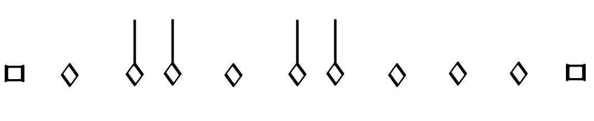
Example: (sequence bounded by breves)
1
2
3
4
5
6
7
7 semibreves = Two groups of 3 semibreves + 1
Example in perfect tempus and minor prolatio
Notes:
So lets take one of such sequences as an example
So here we have 7 semibreves
And what we do is that we group those 7 semibreves into perfect groups (groups of 3 semibreves) and see HOW MANY ARE LEFT OUT
The remainder can only be 1, 2, or None

Slide 13
Number N of semibreves between the boundaries | Number P of perfect groups of semibreves | General Interpretation | Alternative Interpretation
N = 3P + 1 | P >= 0 | Imperfection (by following) | Imperfection (by preceding)
N = 3P + 2 | P = 0 | Alteration | Imperfection (by following) & Imperfection (by preceding)
 | P > 0 | Imperfection (by following) & Imperfection (by preceding) | Alteration
N = 3P | P = 0 | - | -
 | P = 1 |  | Imperfection (by following) & Alteration
 | P > 1 | Imperfection (by following) & Alteration | -
Notes:
3 Remainders
Type of modification (Imperfection, Alteration, Both, or None)

Slide 14
Number N of semibreves between the boundaries | Number P of perfect groups of semibreves | General Interpretation | Alternative Interpretation
N = 3P + 1 | P >= 0 | Imperfection (by following) | Imperfection (by preceding)
N = 3P + 2 | P = 0 | Alteration | Imperfection (by following) & Imperfection (by preceding)
 | P > 0 | Imperfection (by following) & Imperfection (by preceding) | Alteration
N = 3P | P = 0 | - | -
 | P = 1 |  | Imperfection (by following) & Alteration
 | P > 1 | Imperfection (by following) & Alteration | -
Notes:
General interpretation
Situations that do not allow for this [general] interpretation, and FORCE an alternative interpretation:
Dots of division
Rests

Slide 15
Example: (sequence bounded by breves)
1
2
3
4
5
6
7
7 semibreves = Two groups of 3 semibreves + 1
Example in perfect tempus and minor prolatio
Notes:
Continuing with our example
→ General interpretation according to the previous table would be …
FIRST IMP by the notes that FOLLOW
[click]
But as I said,
Situations that do not allow for this interpretation, and force an alternative interpretation:
Most common one → [CLICK!] DOTS OF DIVISION

Slide 16
Example: (sequence bounded by breves)
DOT OF DIVISION
1
2
3
4
5
6
7
7 semibreves = Two groups of 3 semibreves + 1
Example in perfect tempus and minor prolatio
Notes:
→ DOTS OF DIVISION
Used to indicate that the notes belong to different perfections
Use a DOT OF DIVISION between … to indicate that they belong to different perfections
➔ So they CANNOT be GROUPED this way anymore!

Slide 17
Example: (sequence bounded by breves)
DOT OF DIVISION
1
2
3
4
5
6
7
7 semibreves = Two groups of 3 semibreves + 1
Example in perfect tempus and minor prolatio
Notes:
Instead, the grouping would be
=> Now the LAST is IMP by the notes PRECEDING

Slide 18
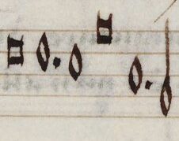
Scoring-up Tool
Deals with the context-dependent nature of mensural notation
By implementing the “principles of imperfection and alteration”
Deals with other non-context-related features:
Dots of augmentation
Coloration
When?
Distinguish between “dots of division” and “dots of augmentation”
division
augmentation
Notes:
[START Content of the Slide]
[In Non-Context Related Features]
Dots of augmentation are …
Coloration is ...
Difficult part ...

Slide 19
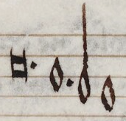
Scoring-up Tool
Deals with the context-dependent nature of mensural notation
By implementing the “principles of imperfection and alteration”
Deals with other non-context-related features:
Dots of augmentation
Coloration
division
When?
Distinguish between “dots of division” and “dots of augmentation”
augmentation
When does coloration affect the note value?
Notes:
So, just to show you how the scoring-up tool works

Slide 20
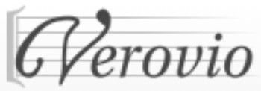
Scoring-up Tool
Mensural MEI file
________
________
Scoring-up
Tool
Mensural
MEI file
________
________
________
________
________
Superius part
Mensural MEI file
________
________
Contratenor part
SCORE
Mensural MEI file
________
________
Tenor part
Notes:
We have these Mensural MEI files encoding all the notes in each voice
Two types of information regarding the notes:
Pitch and the note-shape
NO DURATION VALUE INFO
ScUp --> Finds out whether a note has its default duration or it has been modified (by imperfection, alteration, or augmentation)
And it includes that information for each note in each of the voices.
Comes out: a single file that includes all the voices, but with that extra bit information that indicates the duration of each note
VEROVIO: Software that allows to display the actual music encoded in these MEI files.

Slide 21
Data used for the Experiment
Pieces from the XIV and XV Centuries
Century | Project | Format | Composers and Sources | Number of Pieces
XIV | Measuring Polyphony Project (Karen Desmond http://measuringpolyphony.org) | Mensural MEI | Vitry, Machaut, Anonymous (Ivrea Codex) | 8
XV | Josquin Research Project (Jesse Rodin, Craig Sapp, Clare Bokulich) | Modern transcriptions converted into Mensural MEI using: SibMEI + Mensural MEI Translator | Du Fay and Ockeghem (GB-Ob, Dijon, Mellon, Laborde, Wolfenbüttel) | Du Fay: 5 Ockeghem: 5

Slide 22
Results
Accuracy: 98%
Only 55 mislabeled notes out of 2866 notes of ambiguous duration
Most common source of error: absence of the dot of division
Notes:
Not all notes are ambiguous, smaller notes are usually binary.
So this 98% accuracy was not calculated against all notes.
Calculated over all the notes that are subject to modification (by imperfection, alteration, followed by a dot, and coloration)

Slide 23
Example: Three Separate Parts
Notes:
15th Century OCKEGHEMS’ piece (L’autre D’antan)
Parts
This is how they look like when rendered in Verovio
Barlines → places where the voices must coincide (PERFECT GROUPINGS!)

Slide 24
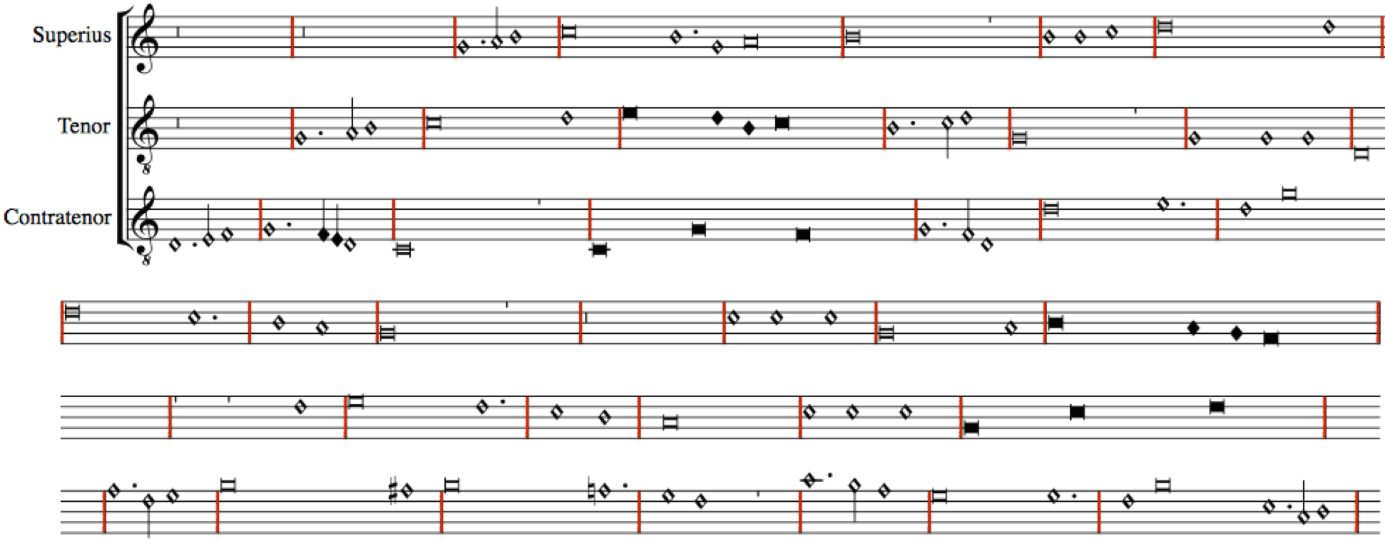
In Quasi-Score Format – Without Scoring-up Tool (notes are not aligned)
Notes:
Say the ”DURATION stuff” HERE TOO
VEROVIO INTERPRETS ALL NOTES AS HAVING THE DURATIONAL VALUE GIVEN BY THE MENSURATION
UNLESS, THE MODIFICATION ON THE DURATION OF A NOTE IS ENCODED WITHIN THE NOTE
WHICH IS WHAT THE SCORING-UP TOOL DOES.
WE NEED TO ENCODE THE EFFECT OF THAT MODIFICATION
THIS IS, WE NEED TO ENCODE THE MODIFIED DURATION.

Slide 25
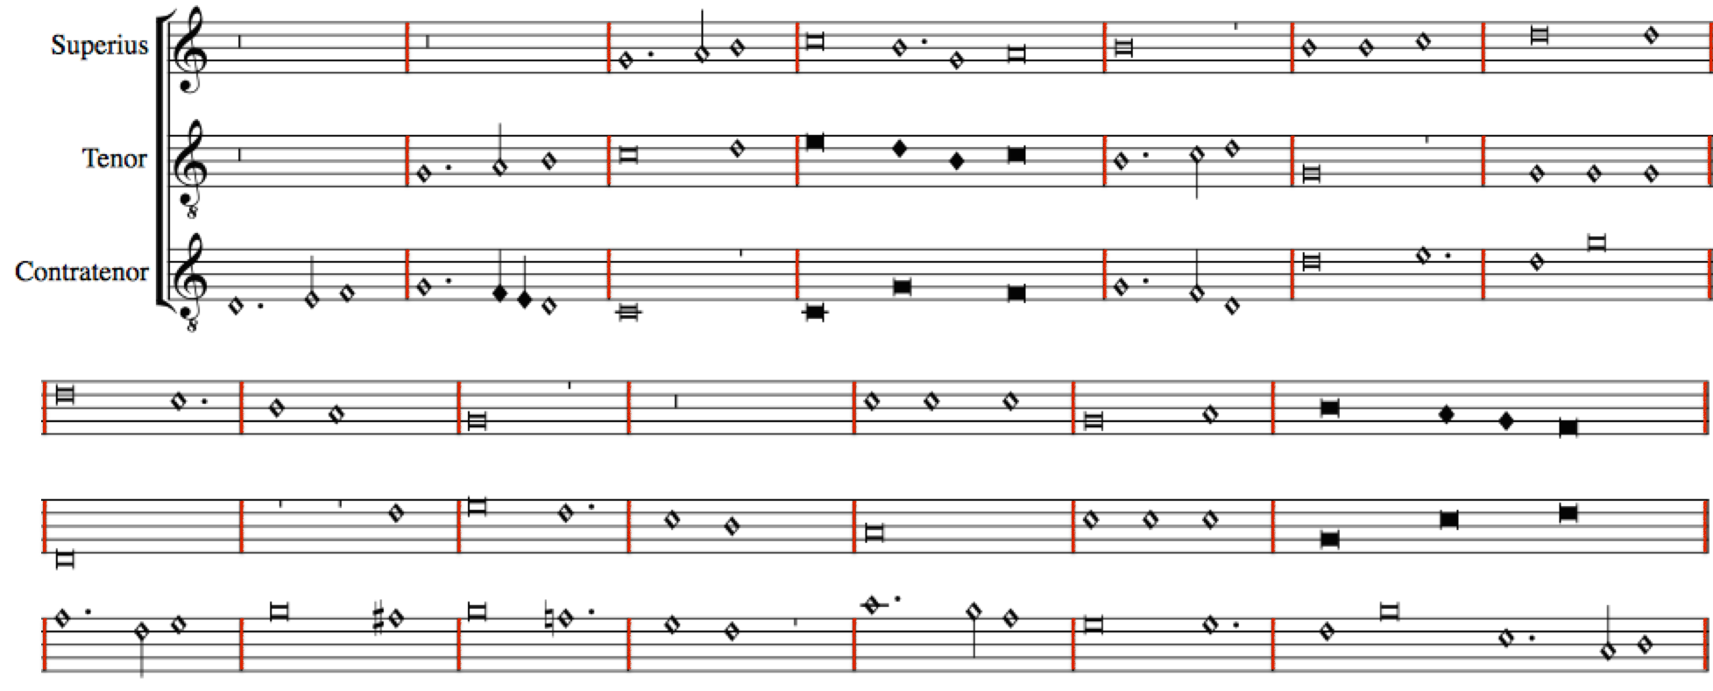
In Score Format – With Scoring-up Tool (modification values encoded)
Notes:
Show here:
The Imperfections
The Alterations
The coloration
The distinct dots

Slide 26
Conclusions
Preserves the original note values
The scoring-up tool presents the piece in score format
Facilitates visualizing the vertical sonorities and studying the relation between the voices of a piece
Notes:
[After 2] which is obscured by the separate-parts layout of the original sources
[After 3] Making it faithful to the source, while providing additional information (regarding the vertical sonorities)

Slide 27
Future work
Mensural MEI file
________
________
________
OMR
Optical Music Recognition (OMR)
Similar to Optical Character Recognition (OCR)
Superius part
Mensural MEI file
________
________
OMR
Contratenor part
Mensural MEI file
________
________
________
OMR
Tenor part
Notes:
For future work, we will use Optical Music Recognition (OMR) to …
OMR works just as OCR (Optical Character Recognition), with OCR you can scan a page of text and recognize the characters. In OMR, you can scan a page of music and recognize the notes.
We will use OMR to [click] (note shape and pitch)
We are developing these tools at McGill, currently for chant.

Slide 28
Future work
Mensural MEI file
_______
_______
Scoring-up
Tool
Mensural
MEI file
________
________
________
________
Superius part
Mensural MEI file
_______
_______
Contratenor part
SCORE
Mensural MEI file
_______
_______
Tenor part
Notes:
Then, we will score these up.

Slide 29
Future work
Mensural MEI file
_______
_______
Scoring-up
Tool
OMR
Mensural
MEI file
________
________
________
________
Superius part
OMR
Mensural MEI file
_______
_______
Contratenor part
SCORE
Mensural MEI file
_______
_______
OMR
Tenor part
Notes:
A procedure of two parts:
From which we would obtain the Mensural MEI files encoding each voice. These files capture only the information present in the sources (this is, pitch and note symbols)
These are the input files of the Scoring-up, which finds the durational values of all the notes within these files based on contextual and non-contextual cues and returns the Mensural MEI file encoding the score.

Slide 30
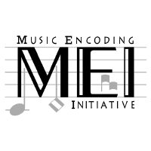
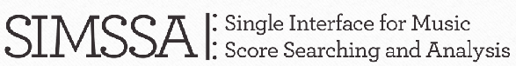

Thank you! martha.thomaeelias@mail.mcgill.ca https://github.com/elvis-project/scoring-up

Slide 31
Sources of Error
Types of Error |  | Instances | Mislabeled Notes
Errors in the sources | Absence of a dot of division | 11 | 25
 | Others | 1 | 1
Errors in the experiment | Placement of the dot of division | 4 | 7
 | Last note | 7 | 7
 | Missing information regarding the staff-line in which a rest lies | 2 | 4
 | Others | 1 | 2
Errors due to situations out of the scope of the principles of imperfection and alteration |  | 5 | 9
 |  |  | 55

Slide 32
Absence of a dot of division

Slide 33
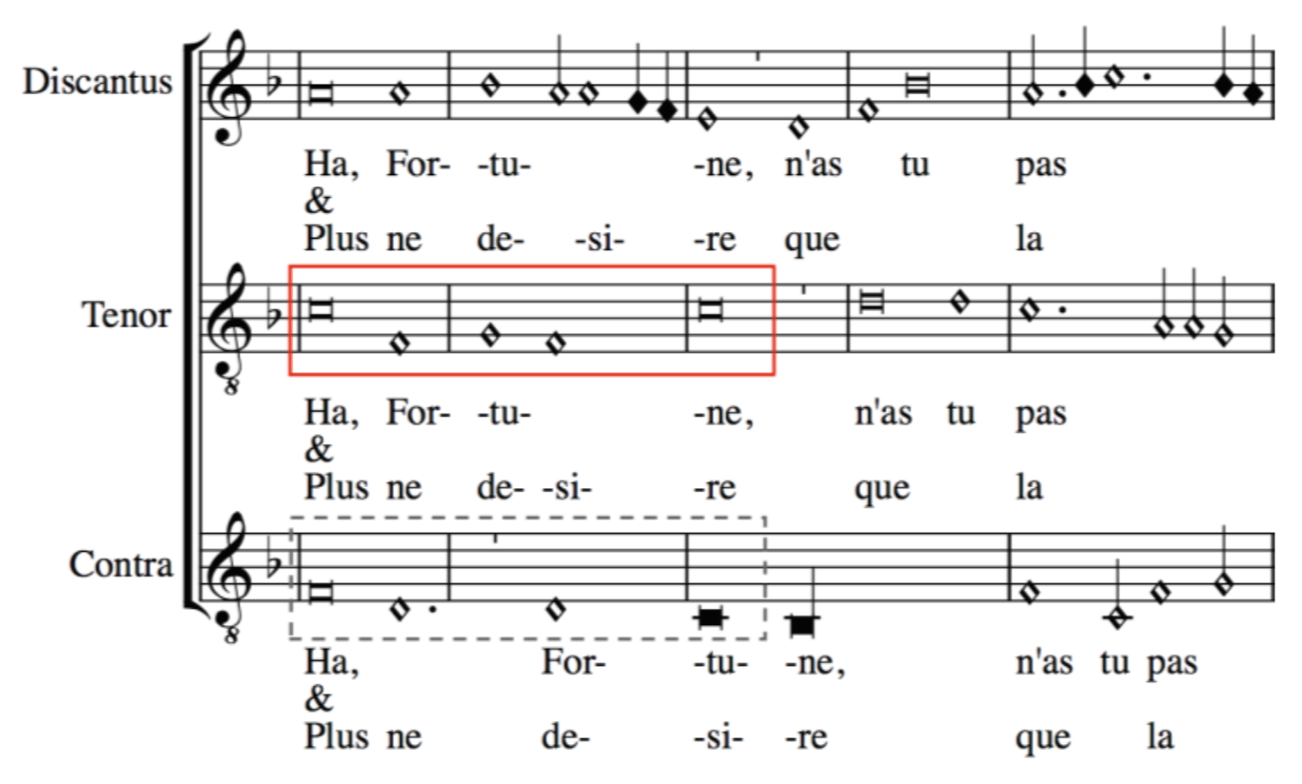

Slide 34
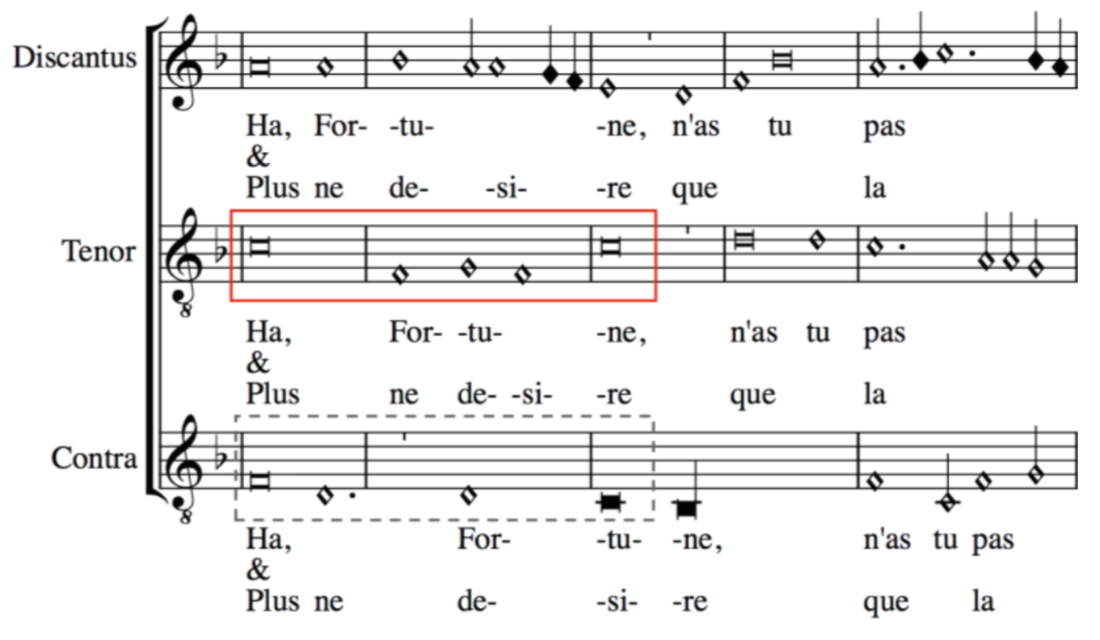

Slide 35
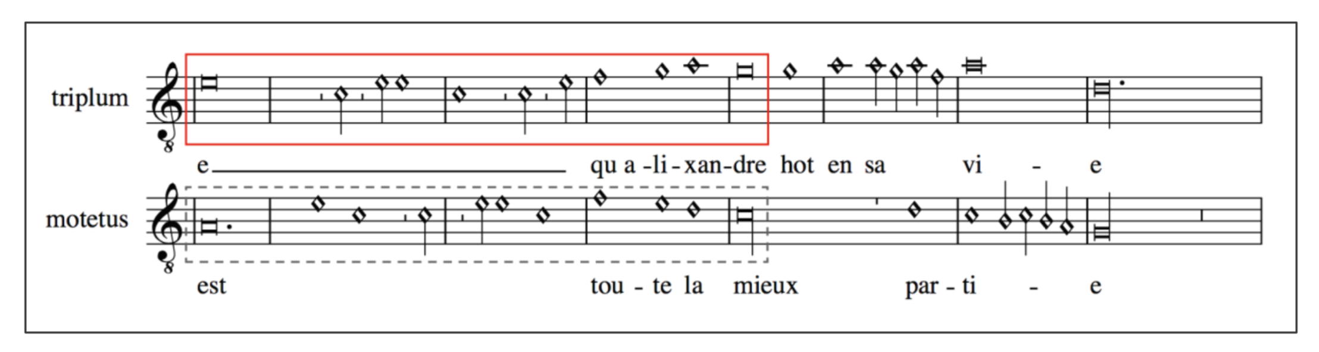

Slide 36
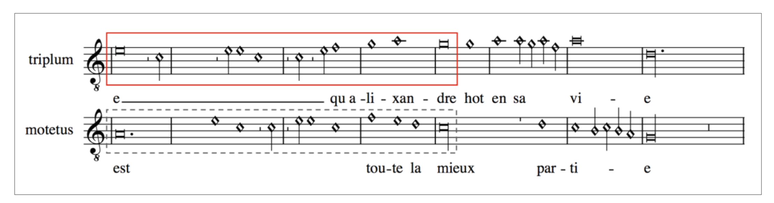

Slide 37
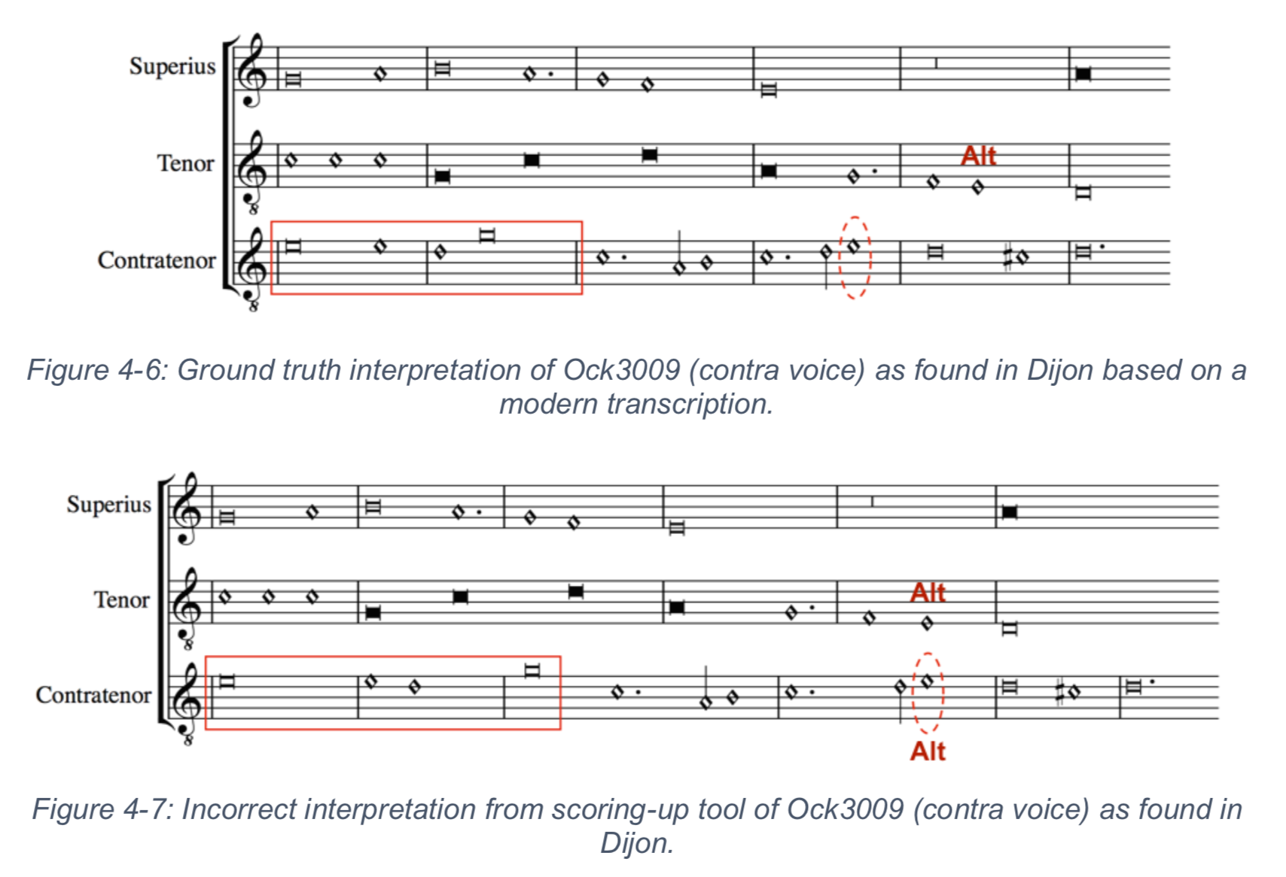

Slide 38
Placement of the dot of division

Slide 39
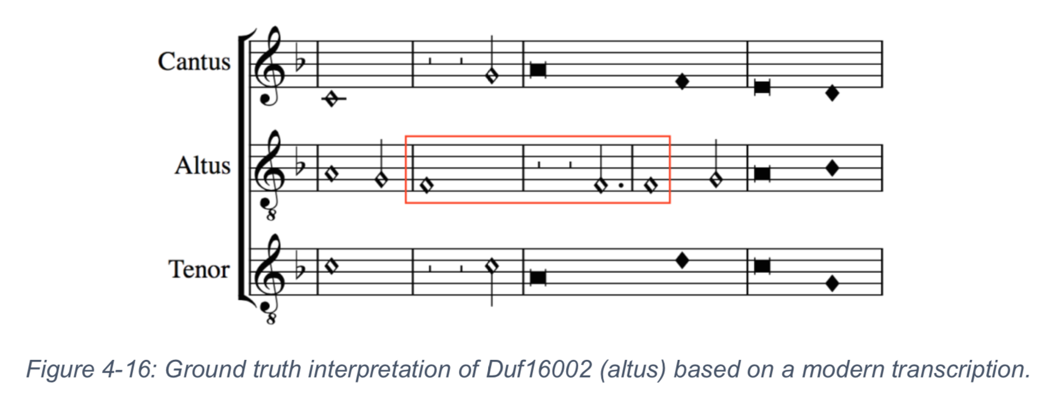

Slide 40
Last note

Slide 41
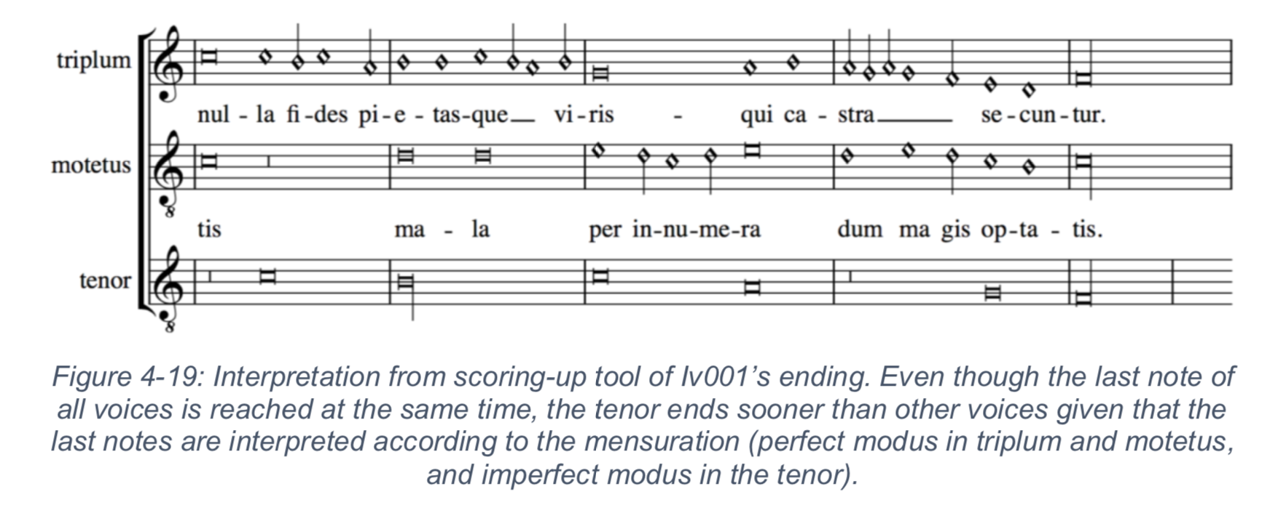

Slide 42
Missing information regarding the staff-line in which a rest lies

Slide 43
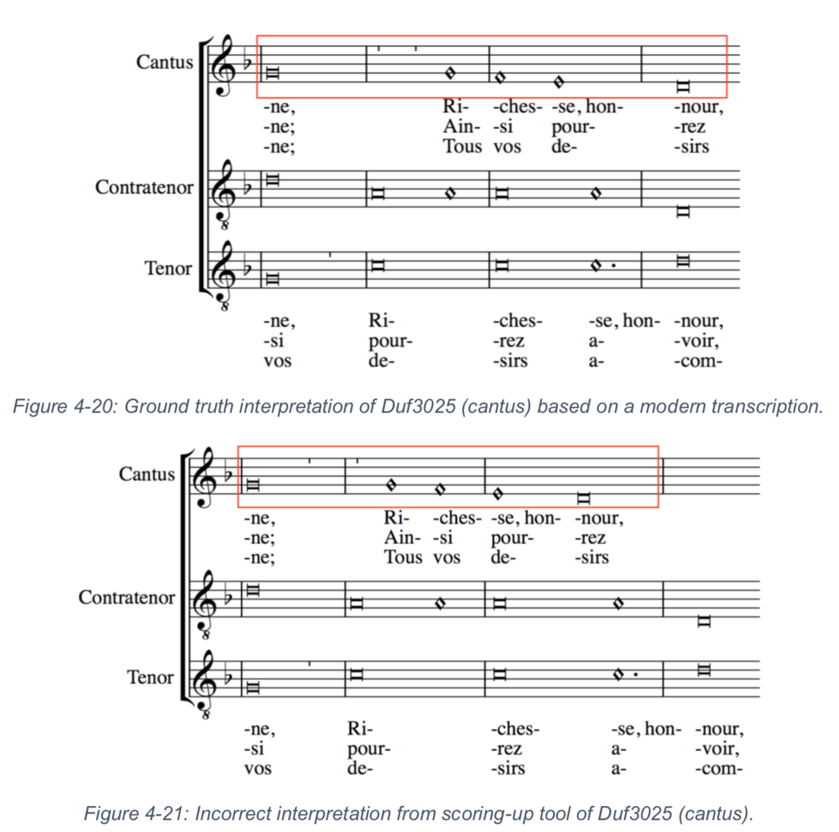

Slide 44
Errors due to situations out of the scope of the principles of imperfection and alteration

Slide 45
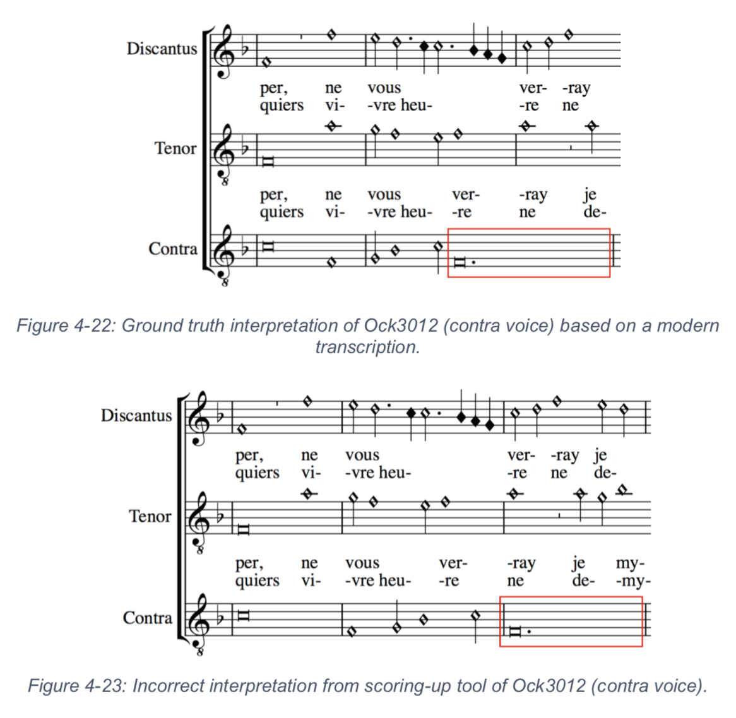

Slide 46
Other errors (sources)

Slide 47
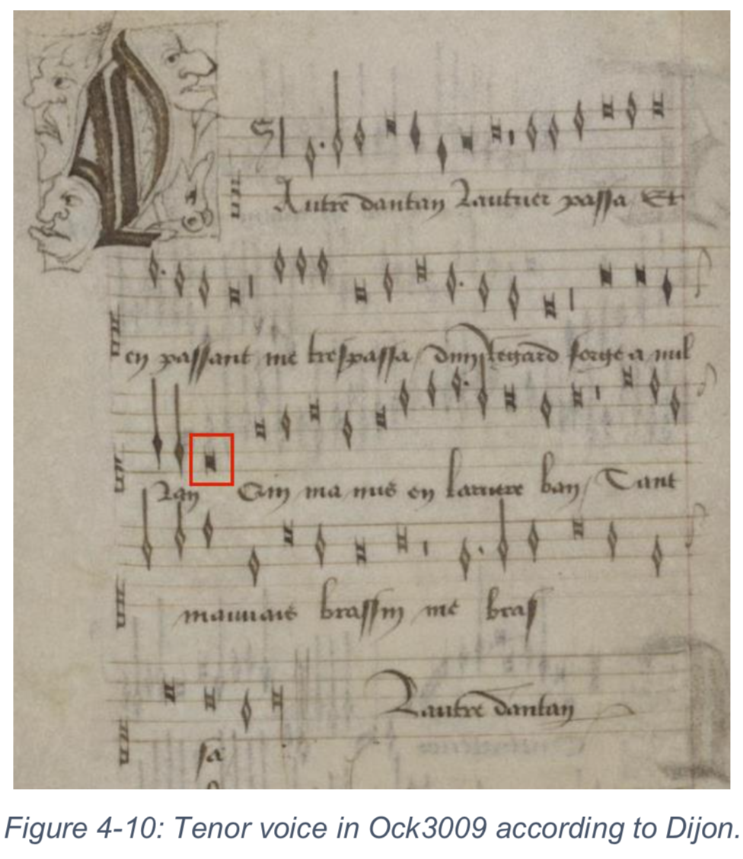
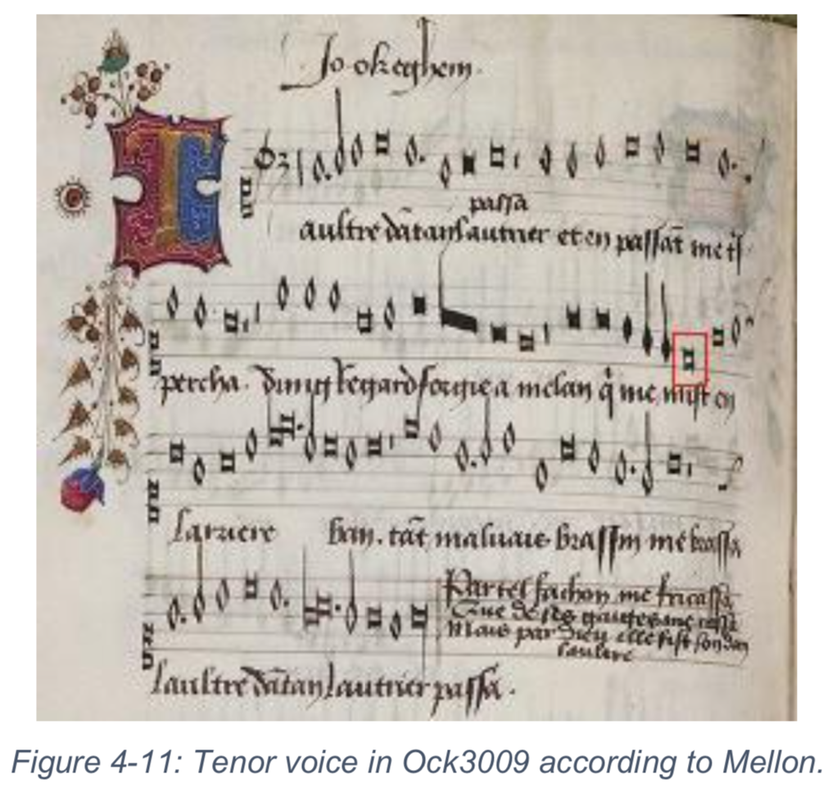

Slide 48
Other errors (experiment)

Slide 49
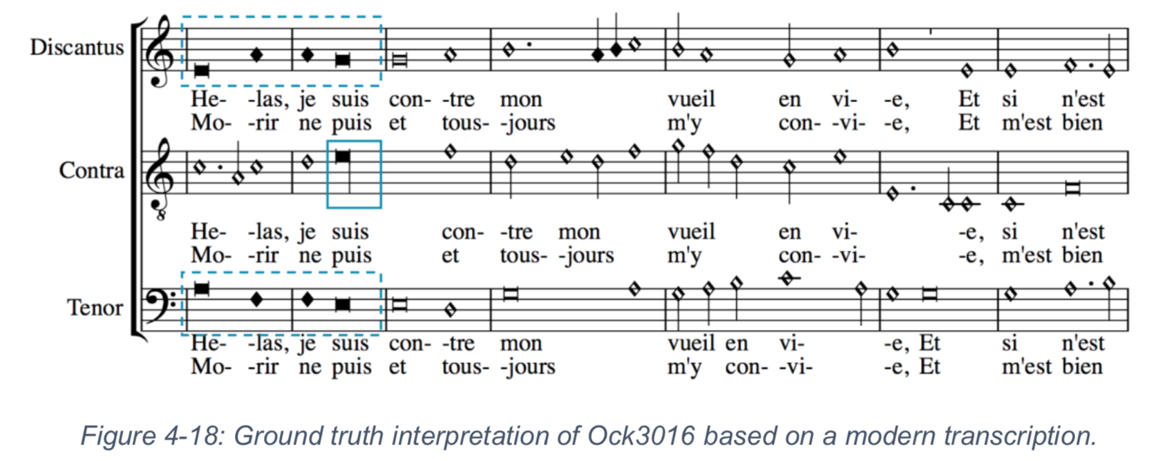
Incompleteness of hemiola group coloration

